Slide 1
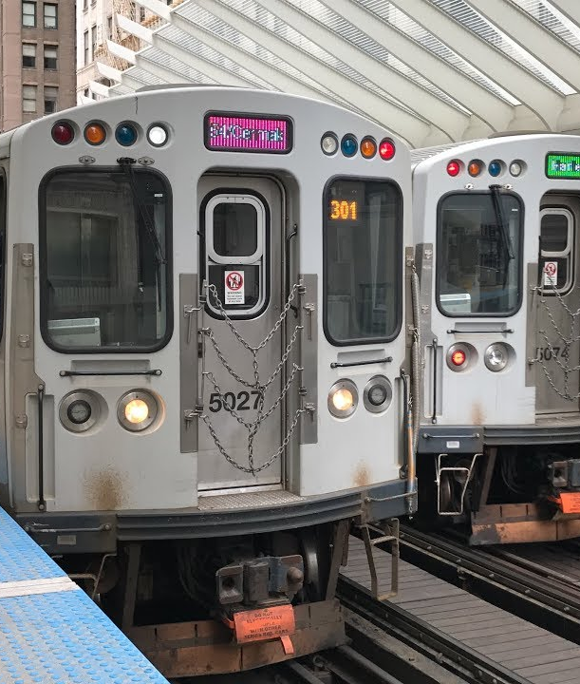
CTA Ridership
Trends
Presenter:
Abel Rodriguez

Slide 2
Focus: CTA Ridership Data Source of Data: transitchicago.com/data/ Kaggle.com (A RESOURCE PROVIDED BY THE U.S. NATIONAL LIBRARY OF MEDICINE) Questions/Ideas: *Most “Popular” Train Stations Visualizations: MAP

Slide 3
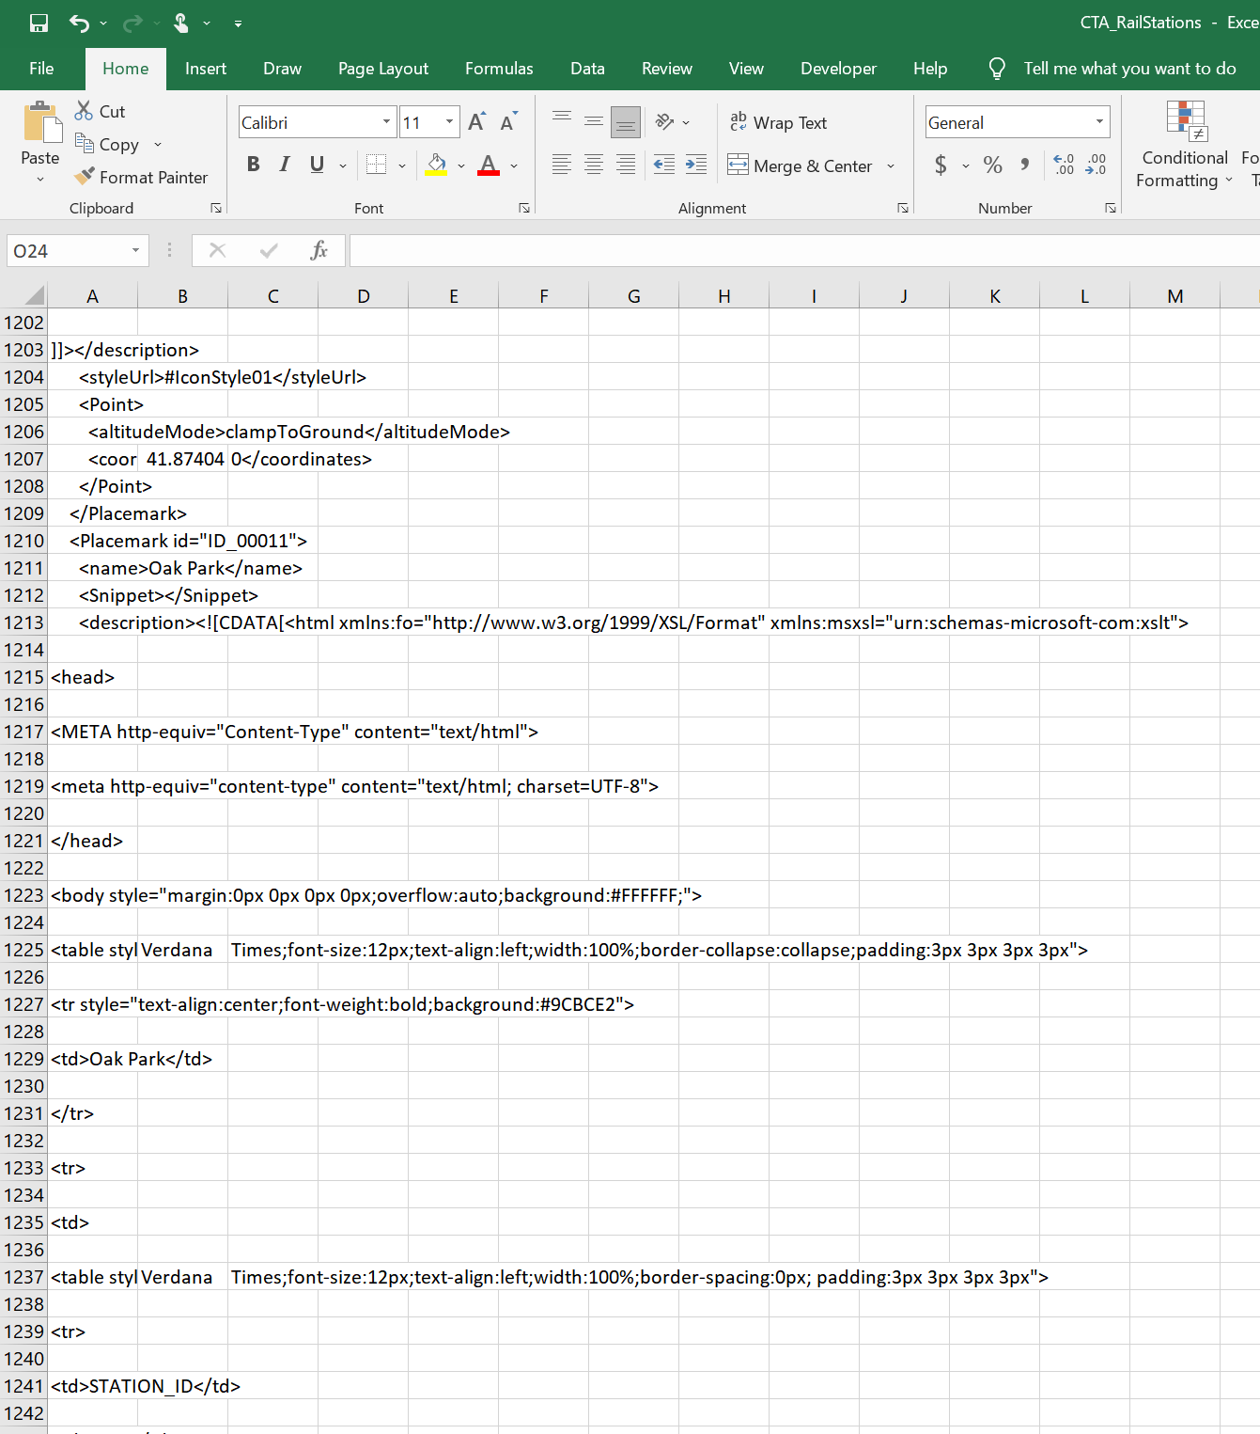
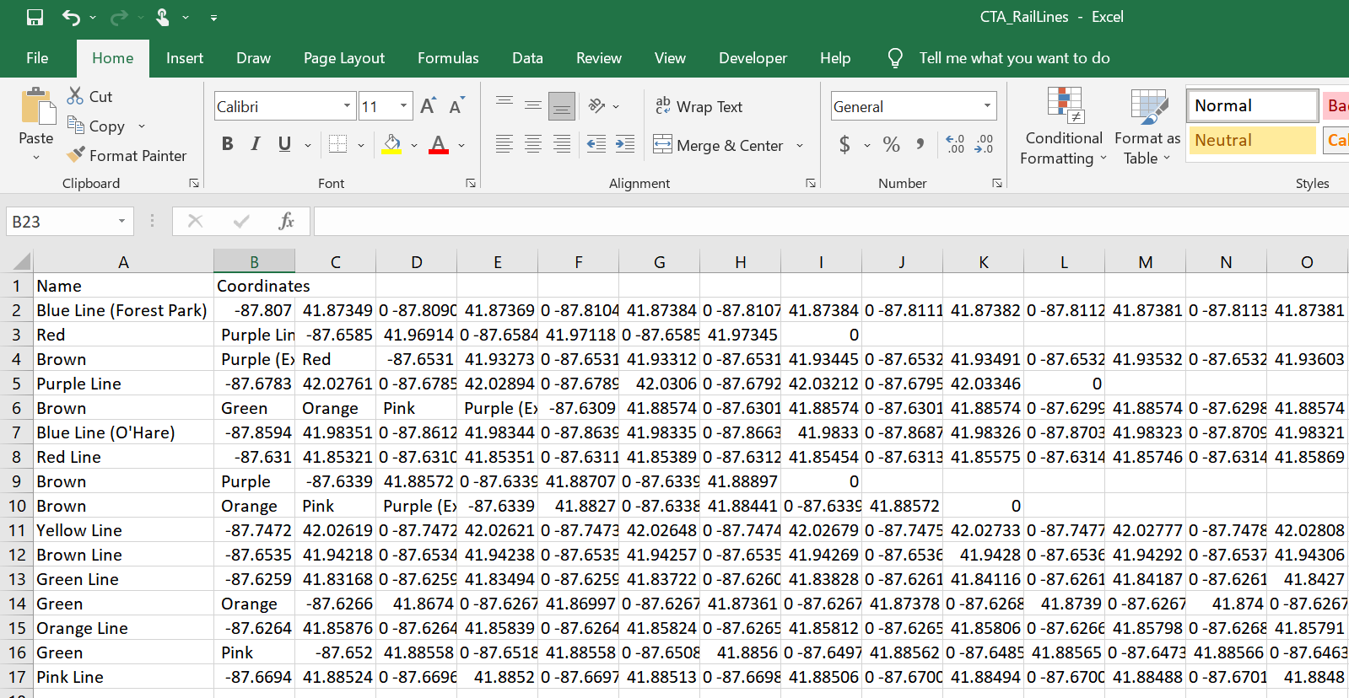
Transformation and Cleaning
CTA Train Stations
CTA Rail lines

Slide 4
Transformation and Cleaning
Convert KMZ files to CSV files
Upload into Pandas Data Frame to Clean Column data
Use Jupyter Notebook to merge Ridership data with Rail Station data (to determine most “popular” stations ) and Rail Line data (to map it out)

